Slide 1
Activity 3.2
By Tan Jia Shun (Alan)
S10198161

Slide 2
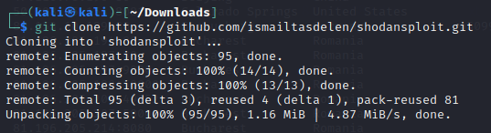
Step 1: download shodansploit

Slide 3
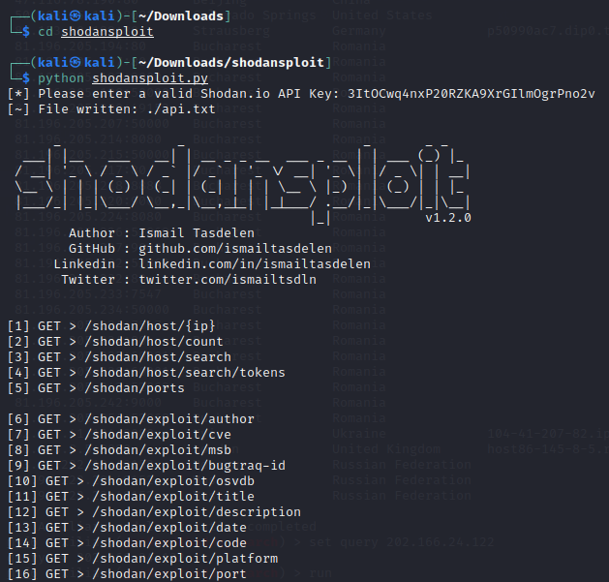
Step 2: run shodansploit

Slide 4
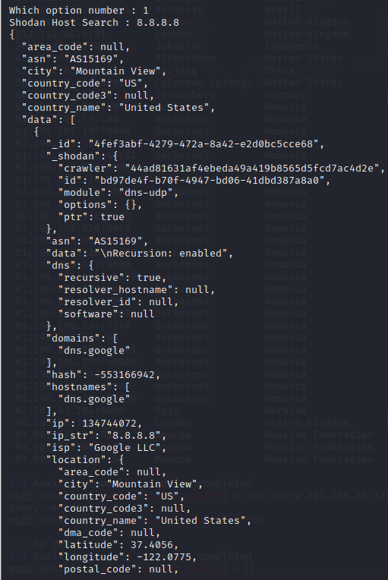
Search

Slide 5

Shodan My IP​

Slide 6
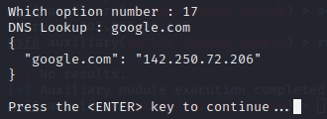
DNS Lookup

